Slide 1
Application layer protocols

Slide 2
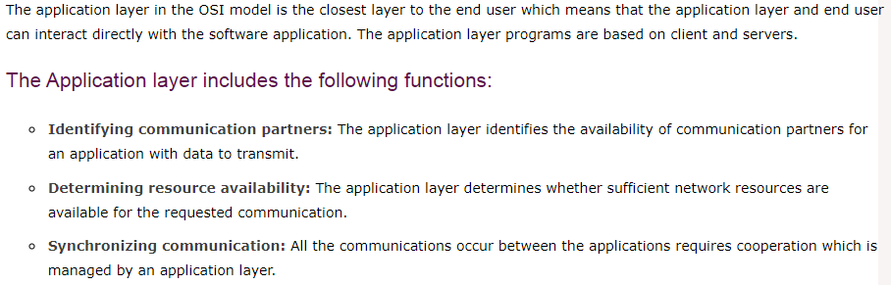

Slide 3
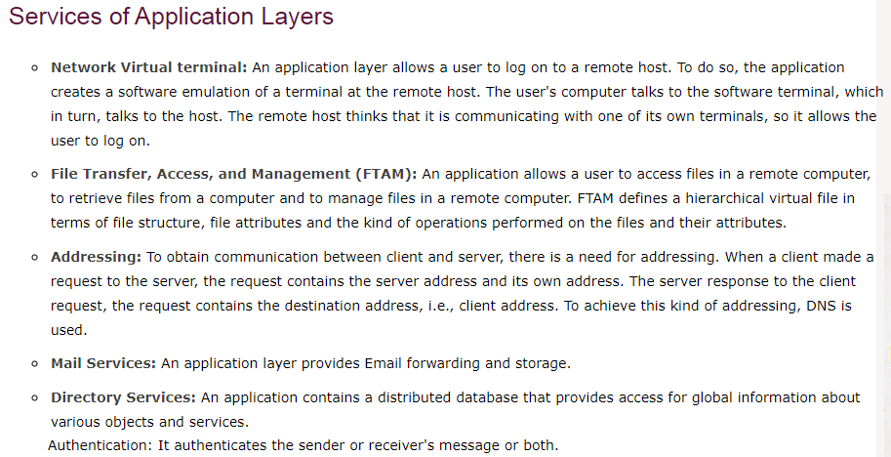

Slide 4
Network Application Architecture
Application architecture is different from the network architecture. The network architecture is fixed and provides a set of services to applications. The application architecture, on the other hand, is designed by the application developer and defines how the application should be structured over the various end systems.

Slide 5
Application architecture is of two types:
Client server architecture:
P2P (peer-to-peer) architecture:

Slide 6
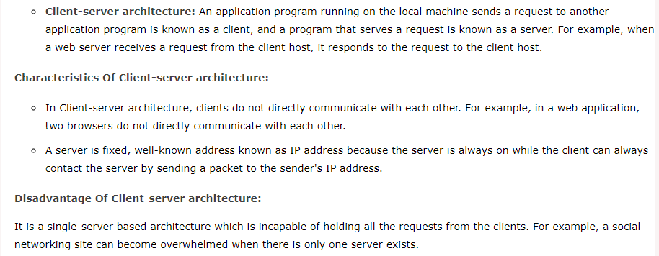

Slide 7
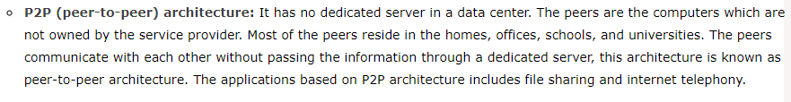

Slide 8
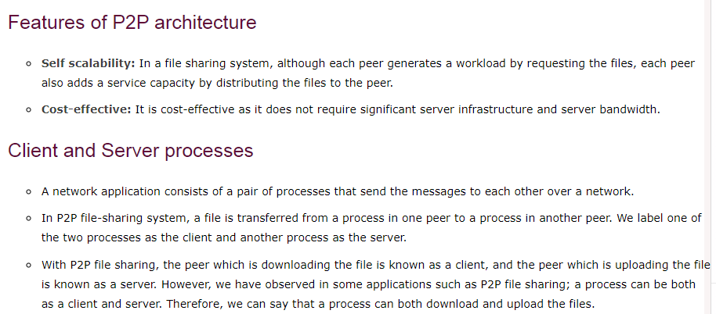

Slide 9
Client and Server model
A client and server networking model is a model in which computers such as servers provide the network services to the other computers such as clients to perform a user based tasks. This model is known as client-server networking model.
The application programs using the client-server model should follow the given below strategies:

Slide 10
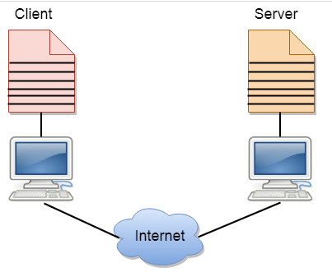

Slide 11
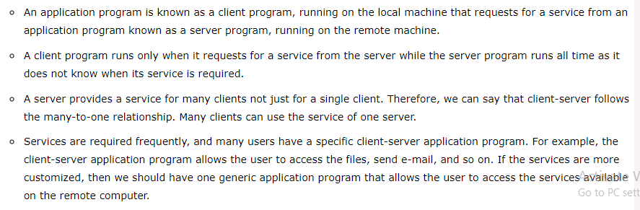

Slide 12
Client
A client is a program that runs on the local machine requesting service from the server. A client program is a finite program means that the service started by the user and terminates when the service is completed.
Server
A server is a program that runs on the remote machine providing services to the clients. When the client requests for a service, then the server opens the door for the incoming requests, but it never initiates the service.
A server program is an infinite program means that when it starts, it runs infinitely unless the problem arises. The server waits for the incoming requests from the clients. When the request arrives at the server, then it responds to the request.

Slide 13
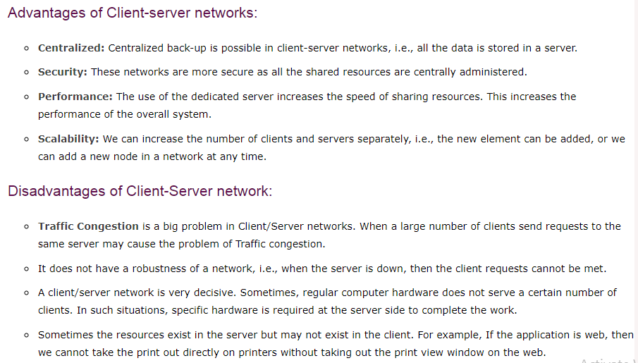

Slide 14
FTP
FTP stands for File transfer protocol.
FTP is a standard internet protocol provided by TCP/IP used for transmitting the files from one host to another.
It is mainly used for transferring the web page files from their creator to the computer that acts as a server for other computers on the internet.
It is also used for downloading the files to computer from other servers.

Slide 15
Objectives of FTP
It provides the sharing of files.
It is used to encourage the use of remote computers.
It transfers the data more reliably and efficiently.

Slide 16
Why FTP?
Although transferring files from one system to another is very simple and straightforward, but sometimes it can cause problems.
For example, two systems may have different file conventions. Two systems may have different ways to represent text and data. Two systems may have different directory structures. FTP protocol overcomes these problems by establishing two connections between hosts. One connection is used for data transfer, and another connection is used for the control connection.

Slide 17
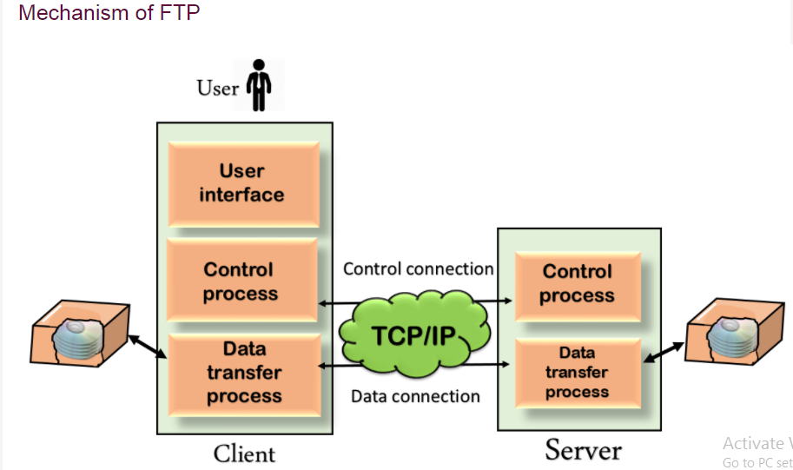

Slide 18
The above figure shows the basic model of the FTP. The FTP client has three components: the user interface, control process, and data transfer process. The server has two components: the server control process and the server data transfer process.

Slide 19
ftp connections
Control Connection: The control connection uses very simple rules for communication. Through control connection, we can transfer a line of command or line of response at a time. The control connection is made between the control processes. The control connection remains connected during the entire interactive FTP session.
Data Connection: The Data Connection uses very complex rules as data types may vary. The data connection is made between data transfer processes. The data connection opens when a command comes for transferring the files and closes when the file is transferred.

Slide 20
FTP Clients
FTP client is a program that implements a file transfer protocol which allows you to transfer files between two hosts on the internet.
It allows a user to connect to a remote host and upload or download the files.
It has a set of commands that we can use to connect to a host, transfer the files between you and your host and close the connection.
The FTP program is also available as a built-in component in a Web browser. This GUI based FTP client makes the file transfer very easy and also does not require to remember the FTP commands.

Slide 21
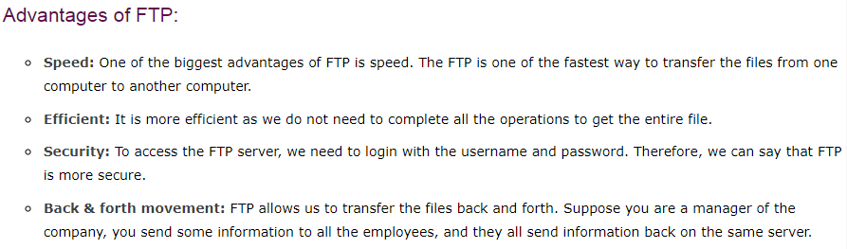

Slide 22
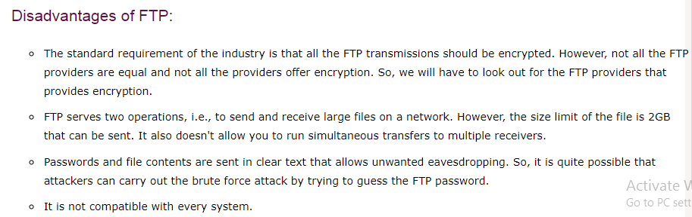

Slide 23

FTP uses the services of TCP. It needs two TCP connections. The well-known port 21 is used for the control connection and the well-known port 20 for the data connection.

Slide 24
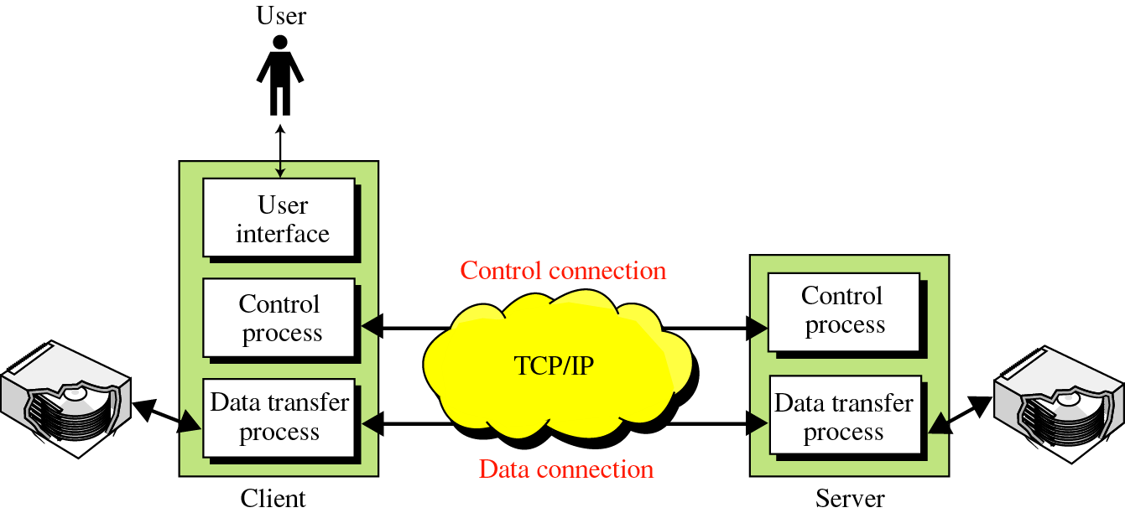
Figure 20-1
FTP

Slide 25
20.1
CONNECTIONS

Slide 26
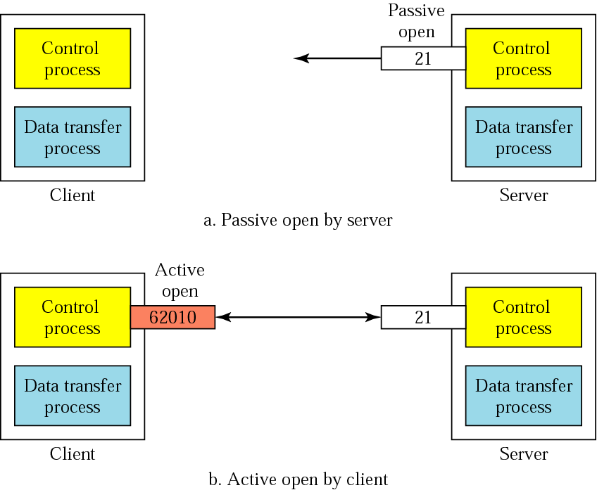
Figure 20-2
Opening the control connection

Slide 27
20.2
COMMUNICATION

Slide 28
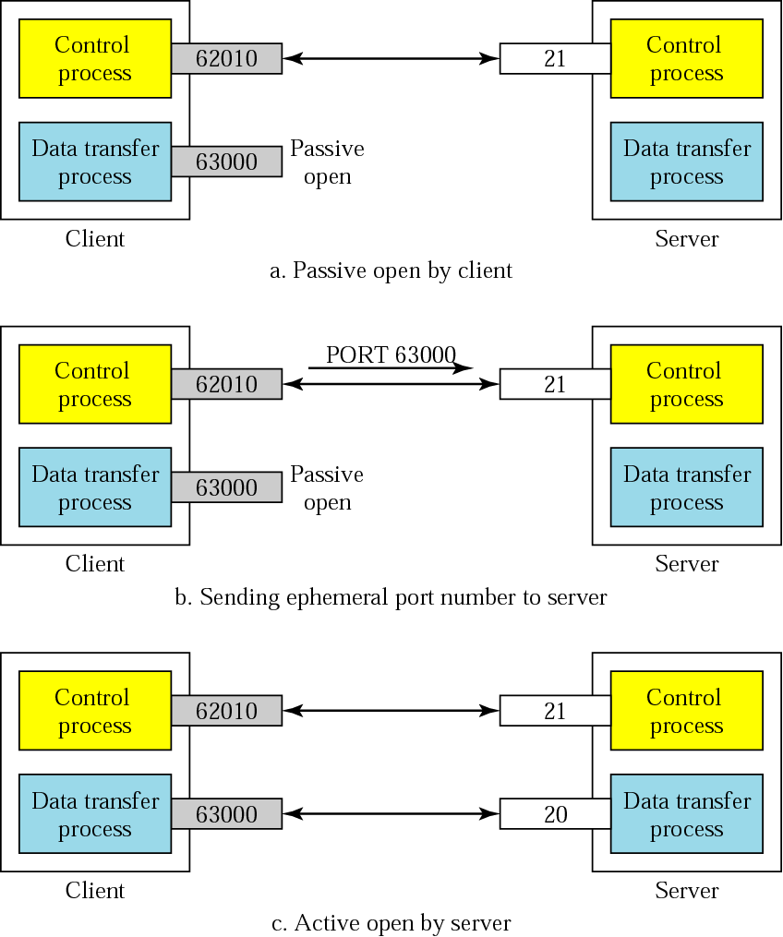
Figure 20-3
Creating
the data
connection

Slide 29
The Data Connection
Uses Server’s well-known port 20
Client issues a passive open on an ephemeral port, say x.
Client uses PORT command to tell the server about the port number x.
Server issues an active open from port 20 to port x.
Server creates a child server/ephemeral port number to serve the client

Slide 30
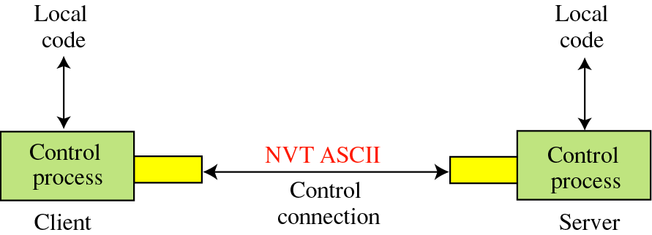
Figure 20-4
Using the control connection

Slide 31
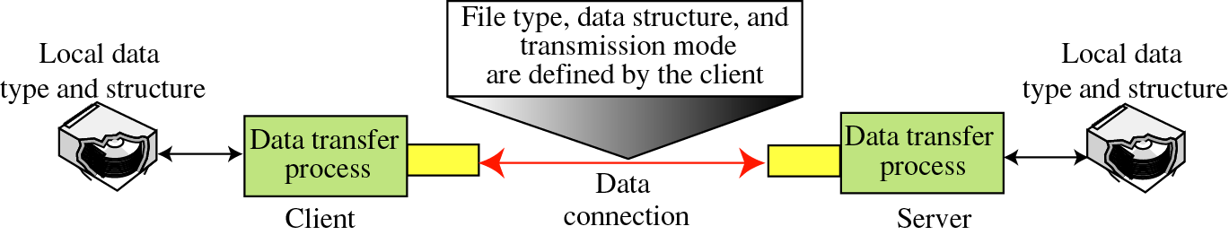
Figure 20-5
Using the data connection

Slide 32
File Type
ASCII or EBCDIC
Nonprint
TELNET
Image

Slide 33
File Type FTP can transfer one of the following ﬁle types across the data connection:
❑ ASCII ﬁle. This is the default format for transferring text ﬁles. Each character is encoded using NVT (Network Virtual Terminal) ASCII. The sender transforms the ﬁle from its own representation into NVT ASCII characters and the receiver transforms the NVT ASCII characters to its own representation.
❑ EBCDIC ﬁle. If one or both ends of the connection use EBCDIC encoding, the ﬁle can be transferred using EBCDIC encoding.
❑ Image ﬁle. This is the default format for transferring binary ﬁles. The ﬁle is sent as continuous streams of bits without any interpretation or encoding. This is mostly used to transfer binary ﬁles such as compiled programs.
If the ﬁle is encoded in ASCII or EBCDIC, another attribute must be added to deﬁne the printability of the ﬁle.
a. Nonprint. This is the default format for transferring a text ﬁle. The ﬁle contains no vertical speciﬁcations for printing. This means that the ﬁle cannot be printed without further processing because there are no characters to be interpreted for vertical movement of the print head. This format is used for ﬁles that will be stored and processed later.
b. TELNET. In this format the ﬁle contains NVT ASCII vertical characters such as CR (carriage return), LF (line feed), NL (new line), and VT (vertical tab). The ﬁle is printable after transfer.

Slide 34
Data Structure
File Structure
Record Structure
Page Structure

Slide 35
Data Structure:
FTP can transfer a ﬁle across the data connection using one of the following interpretations about the structure of the data:
❑ File structure (default). The ﬁle has no structure. It is a continuous stream of bytes.
❑ Record structure. The ﬁle is divided into records. This can be used only with text ﬁles.
❑ Page structure. The ﬁle is divided into pages, with each page having a page number and a page header. The pages can be stored and accessed randomly or sequentially.

Slide 36
Transmission Mode
Stream mode
Block mode
Compressed mode

Slide 37
Transmission Mode FTP can transfer a ﬁle across the data connection using one of the following three transmission modes:
❑ Stream mode. This is the default mode. Data are delivered from FTP to TCP as a continuous stream of bytes. TCP is responsible for chopping data into segments of appropriate size. If the data is simply a stream of bytes (file structure), no end-ofﬁle is needed. End-of-ﬁle in this case is the closing of the data connection by the sender. If the data are divided into records (record structure), each record will have a 1-byte end-of-record (EOR) character and the end of the ﬁle will have a 1-byte end-of-ﬁle (EOF) character.
❑ Block mode. Data can be delivered from FTP to TCP in blocks. In this case, each block is preceded by a 3-byte header. The ﬁrst byte is called the block descriptor; the next two bytes deﬁne the size of the block in bytes.
❑ Compressed mode. If the ﬁle is big, the data can be compressed. The compression method normally used is run-length encoding. In this method, consecutive appearances of a data unit are replaced by one occurrence and the number of repetitions. In a text ﬁle, this is usually spaces (blanks). In a binary ﬁle, null characters are usually compressed.

Slide 38
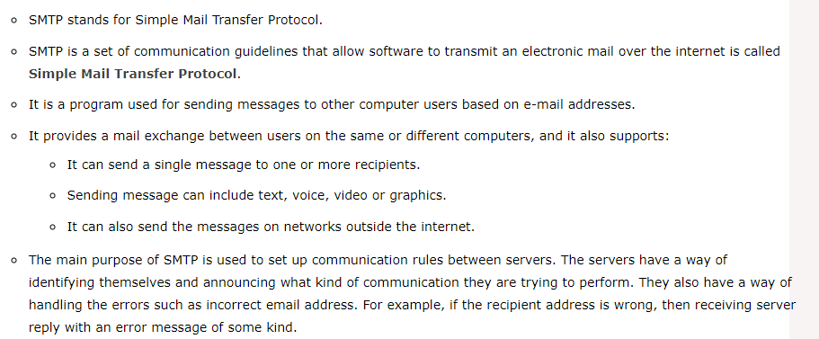
Smtp

Slide 39
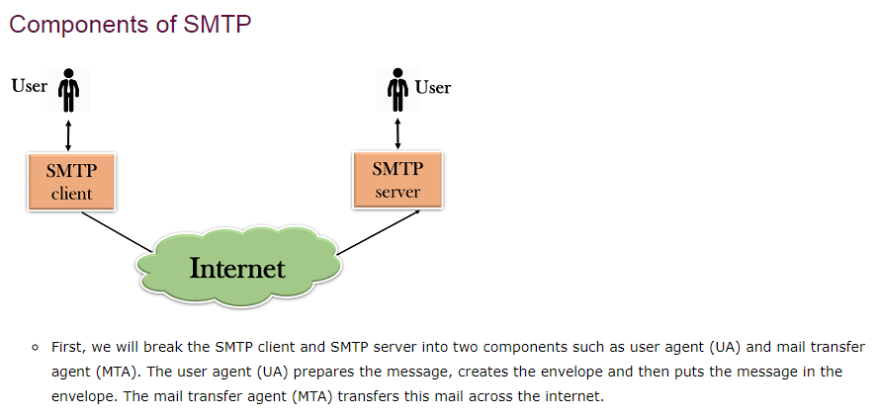

Slide 40
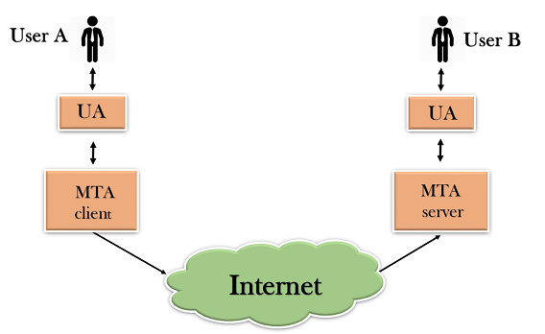

Slide 41
SMTP allows a more complex system by adding a relaying system. Instead of just having one MTA at sending side and one at receiving side, more MTAs can be added, acting either as a client or server to relay the email.
An SMTP relay provider can help businesses and organizations deliver large volumes of email without getting them mislabeled as spam or running up against small sending limits.
An SMTP relay service guarantees that sent emails arrive in their recipients’ inboxes.

Slide 42
What is an SMTP relay service?
SMTP Relay is a service that routes email through a trusted 3rd party to deliver your bulk email. It most often specializes in sending large batches of emails (newsletters) or for automatic transactional emails (delivery confirmations, password resets, etc)

Slide 43
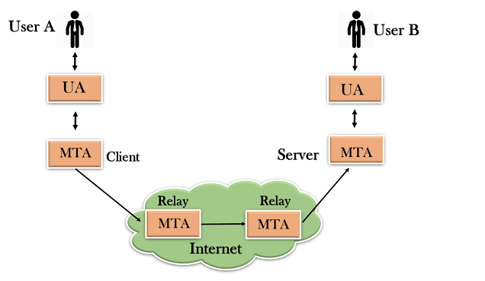

Slide 44
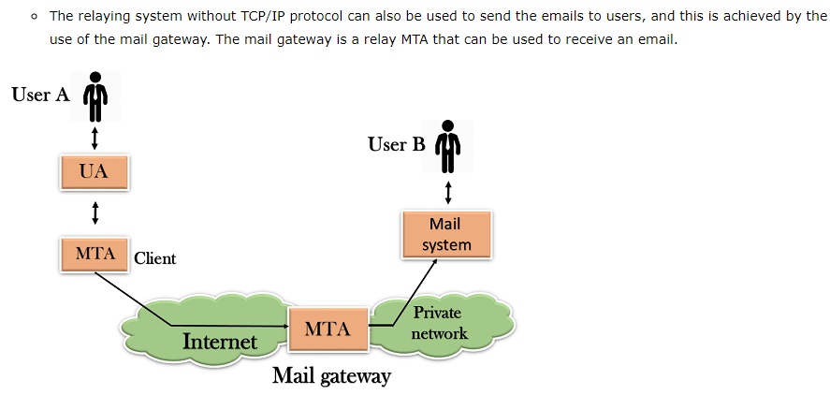

Slide 45
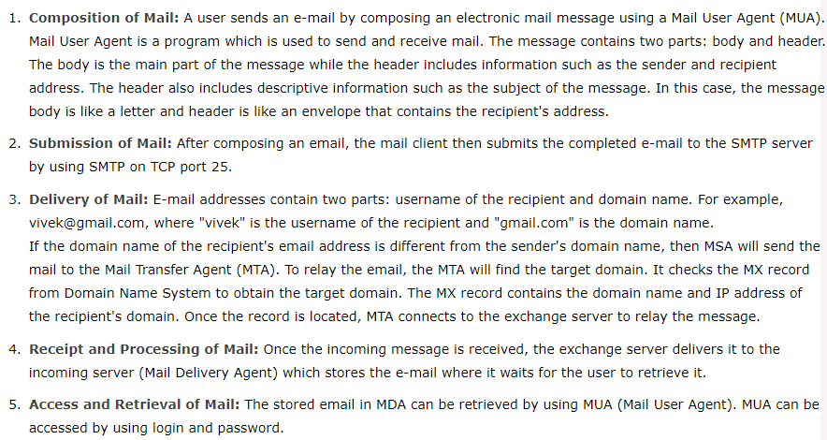
Working of Smtp

Slide 46
SNMP
SNMP stands for Simple Network Management Protocol.
SNMP is a framework used for managing devices on the internet.
It provides a set of operations for monitoring and managing the internet.

Slide 47
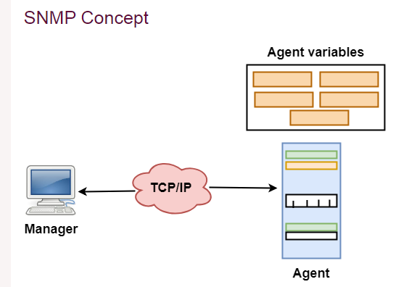

Slide 48
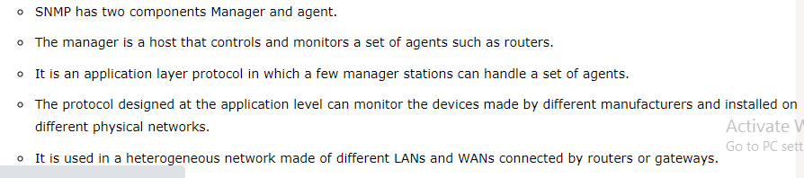

Slide 49
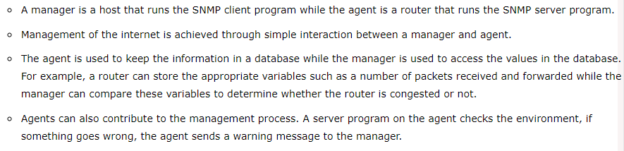
Managers & Agents

Slide 50
Management with SNMP has three basic ideas:
A manager checks the agent by requesting the information that reflects the behavior of the agent.
A manager also forces the agent to perform a certain function by resetting values in the agent database.
An agent also contributes to the management process by warning the manager regarding an unusual condition.

Slide 51
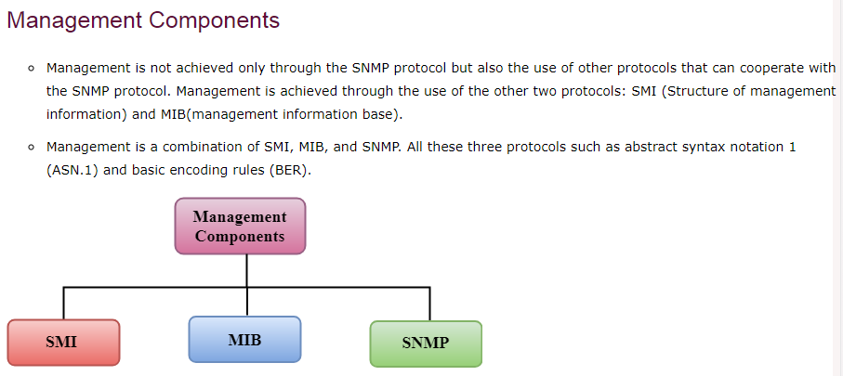

Slide 52
SMI
The SMI (Structure of management information) is a component used in network management. Its main function is to define the type of data that can be stored in an object and to show how to encode the data for the transmission over a network.
MIB
The MIB (Management information base) is a second component for the network management.
Each agent has its own MIB, which is a collection of all the objects that the manager can manage. MIB is categorized into eight groups: system, interface, address translation, ip, icmp, tcp, udp, and egp. These groups are under the mib object.

Slide 53
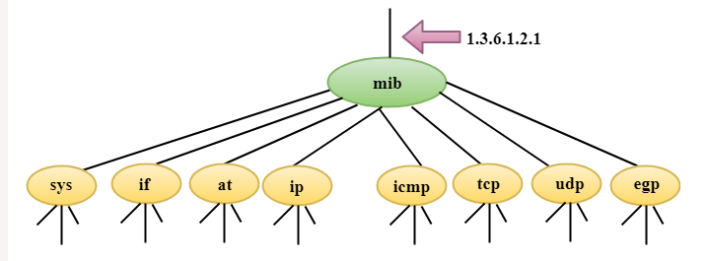

Slide 54
SNMP:It defines the structure of packets that is shared between a manager and an agent.
SMI (Structure of Management Information): SMI is a network management component that defines the standard rules for the naming object and object type (including range and length) and also shows how to encode objects and values.
MIB (Management Information Base): MIB is the second component of the network management. It is virtual information storage where management information is stored.

Slide 55
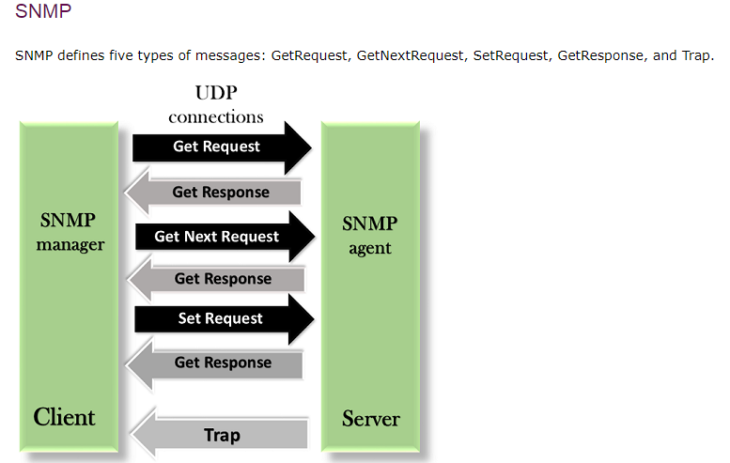

Slide 56
GetRequest: The GetRequest message is sent from a manager (client) to the agent (server) to retrieve the value of a variable.
GetNextRequest: The GetNextRequest message is sent from the manager to agent to retrieve the value of a variable. This type of message is used to retrieve the values of the entries in a table. If the manager does not know the indexes of the entries, then it will not be able to retrieve the values. In such situations, GetNextRequest message is used to define an object.
GetResponse: The GetResponse message is sent from an agent to the manager in response to the GetRequest and GetNextRequest message. This message contains the value of a variable requested by the manager.
SetRequest: The SetRequest message is sent from a manager to the agent to set a value in a variable.
Trap: The Trap message is sent from an agent to the manager to report an event. For example, if the agent is rebooted, then it informs the manager as well as sends the time of rebooting.

Slide 57
GetBulkRequest: It is used by the SNMP manager to retrieve the large data from the SNMP agent.

Slide 58
A quick revision of snmp:

Slide 59
23.2
MANAGEMENT
COMPONENTS

Slide 60
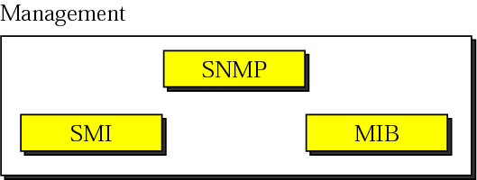
Figure 23-2
Components of network
management on the Internet

Slide 61
SNMP defines the format of packets exchanged between a manager and an agent. It reads and changes the status (values) of objects (variables) in SNMP packets.

Slide 62
SMI defines the general rules for naming objects, defining object types (including range and length), and showing how to encode objects and values.

Slide 63
SMI defines neither the number of objects an entity should manage, nor names the objects to be managed nor defines the association between the objects and their values.

Slide 64
MIB creates a collection of named objects, their types, and their relationships to each other in an entity to be managed.

Slide 65
We can compare the task of network management to the task of writing a program. 1. Both tasks need rules. In network management this is handled by SMI. 2. Both tasks need variable declarations. In network management this is handled by MIB. 3. Both tasks have actions performed by statements.In network management this is handled by SNMP.

Slide 66
HTTP ::HyperText Transfer Protocol.
It is a protocol used to access the data on the World Wide Web (www).
The HTTP protocol can be used to transfer the data in the form of plain text, hypertext, audio, video, and so on.
This protocol is known as HyperText Transfer Protocol because of its efficiency that allows us to use in a hypertext environment where there are rapid jumps from one document to another document.
HTTP is similar to the FTP as it also transfers the files from one host to another host. But, HTTP is simpler than FTP as HTTP uses only one connection, i.e., no control connection to transfer the files.
HTTP is similar to SMTP as the data is transferred between client and server. The HTTP differs from the SMTP in the way the messages are sent from the client to the server and from server to the client. SMTP messages are stored and forwarded while HTTP messages are delivered immediately.

Slide 67
Features of HTTP:
Connectionless protocol: HTTP is a connectionless protocol. HTTP client initiates a request and waits for a response from the server. When the server receives the request, the server processes the request and sends back the response to the HTTP client after which the client disconnects the connection. The connection between client and server exist only during the current request and response time only.
Media independent: HTTP protocol is a media independent as data can be sent as long as both the client and server know how to handle the data content. It is required for both the client and server to specify the content type in MIME-type header.
Stateless: HTTP is a stateless protocol as both the client and server know each other only during the current request. Due to this nature of the protocol, both the client and server do not retain the information between various requests of the web pages.

Slide 68
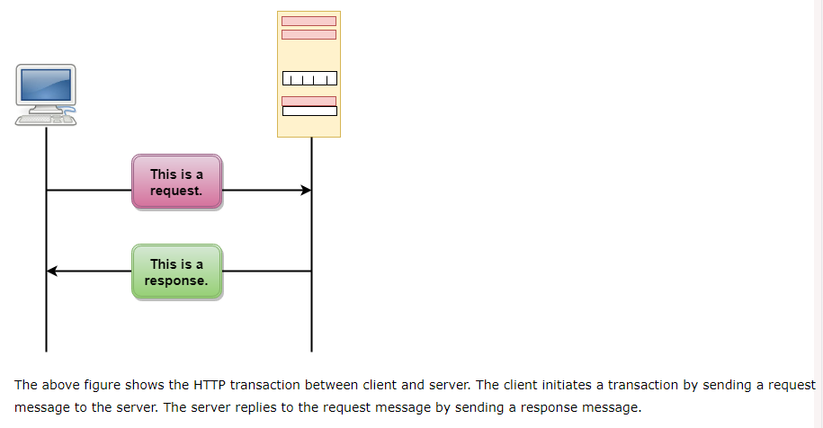
HTTP Transactions

Slide 69
Messages
HTTP messages are of two types: request and response. Both the message types follow the same message format.

Slide 70
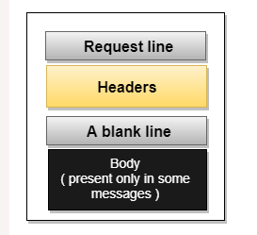

Slide 71
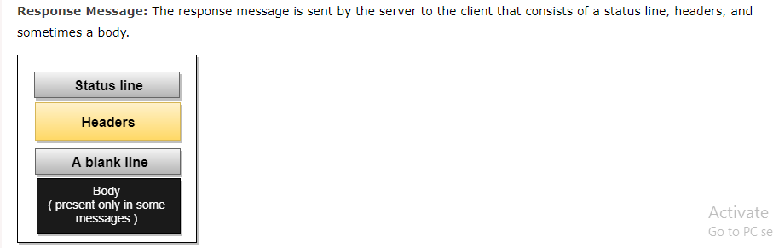

Slide 72
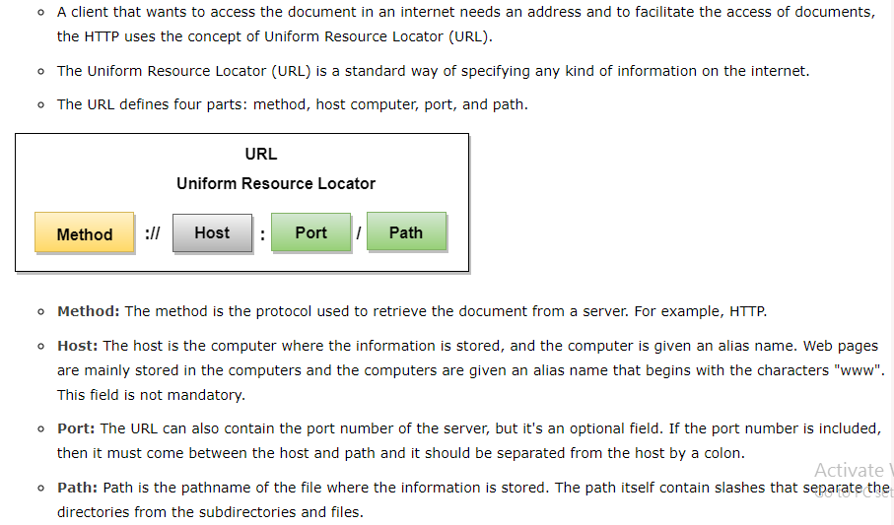
Uniform Resource Locator

Slide 73
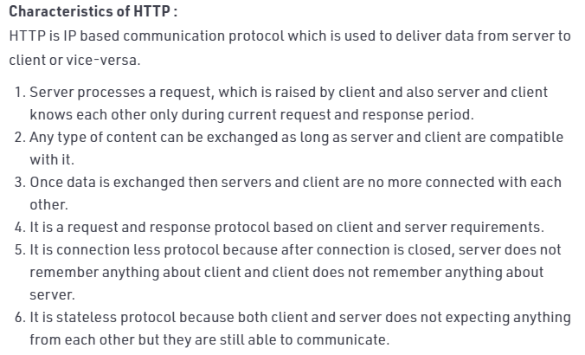

Slide 74
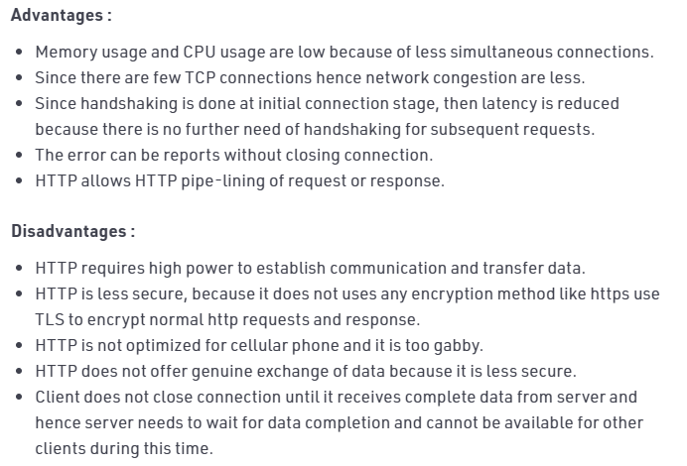

Slide 75
World Wide Web
(WWW)

Slide 76
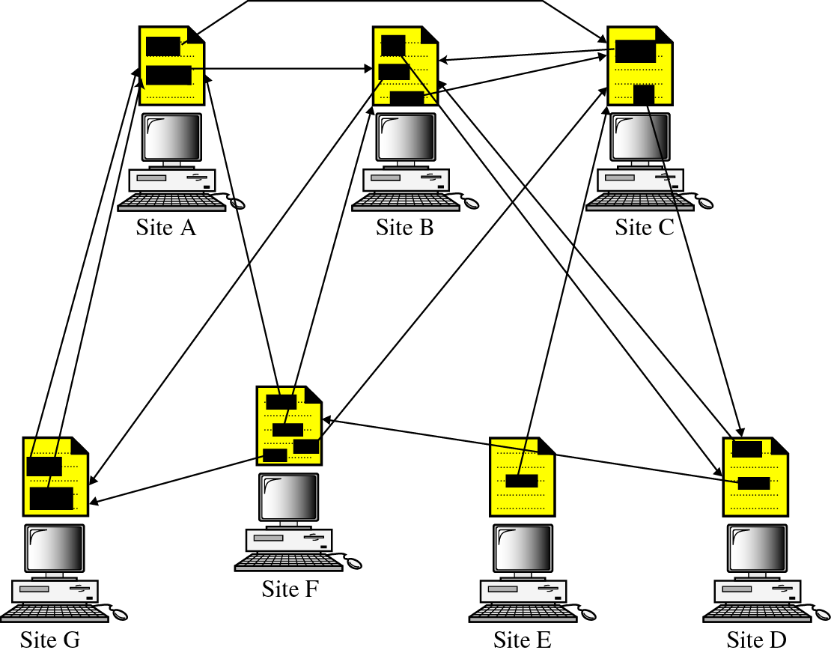
Figure 25-1
Distributed services

Slide 77
25.1
HYPERTEXT
AND
HYPERMEDIA

Slide 78
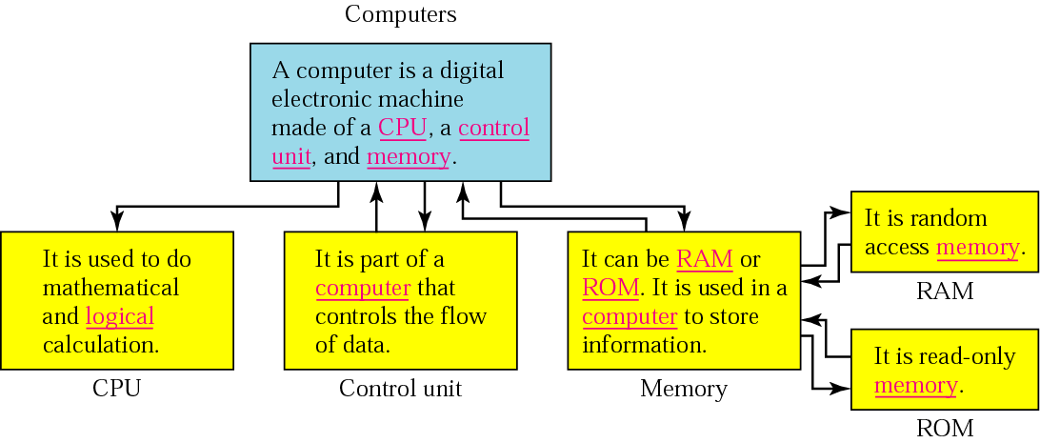
Figure 25-2
Hypertext

Slide 79
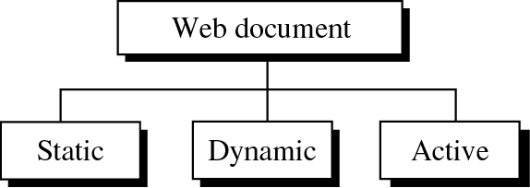
Figure 25-4
Categories of Web documents

Slide 80
25.3
STATIC
DOCUMENTS

Slide 81
Static documents are ﬁxed-content documents that are created and stored in a server. The client can get a copy of the document only

Slide 82
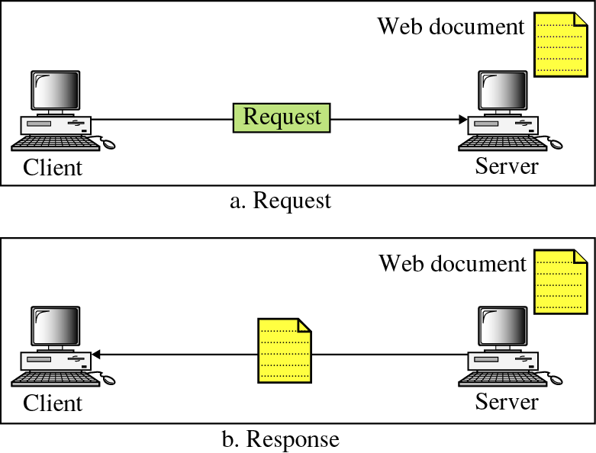
Figure 25-5
Static document

Slide 83
25.5
DYNAMIC
DOCUMENTS

Slide 84
A dynamic document is created by a Web server whenever a browser requests the document. When a request arrives, the Web server runs an application program or a script that creates the dynamic document. The server returns the output of the program or script as a response to the browser that requested the document. Because a fresh document is created for each request, the contents of a dynamic document may vary from one request to another.
A very simple example of a dynamic document is the retrieval of the time and date from a server. Time and date are kinds of information that are dynamic in that they change from moment to moment. The client can ask the server to run a program such as the date program in UNIX and send the result of the program to the client.

Slide 85
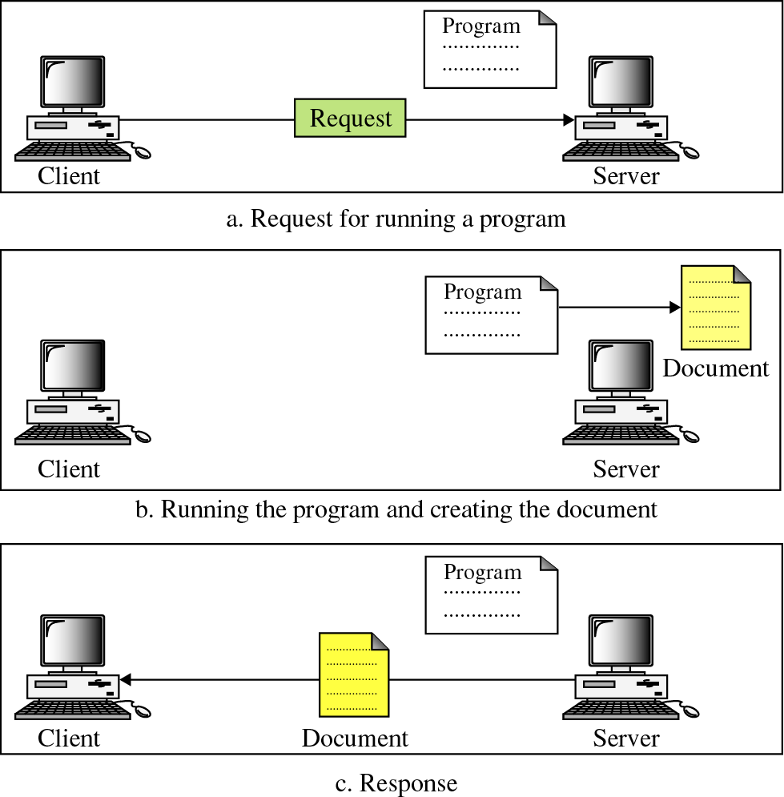
Figure 25-9
Dynamic
document

Slide 86
25.7
ACTIVE
DOCUMENTS

Slide 87
For many applications, we need a program or a script to be run at the client site. These are called active documents. For example, suppose we want to run a program that creates animated graphics on the screen or a program that interacts with the user. The program deﬁnitely needs to be run at the client site where the animation or interaction takes place. When a browser requests an active document, the server sends a copy of the document or a script. The document is then run at the client (browser) site.
Eg: javascript, applets.

Slide 88
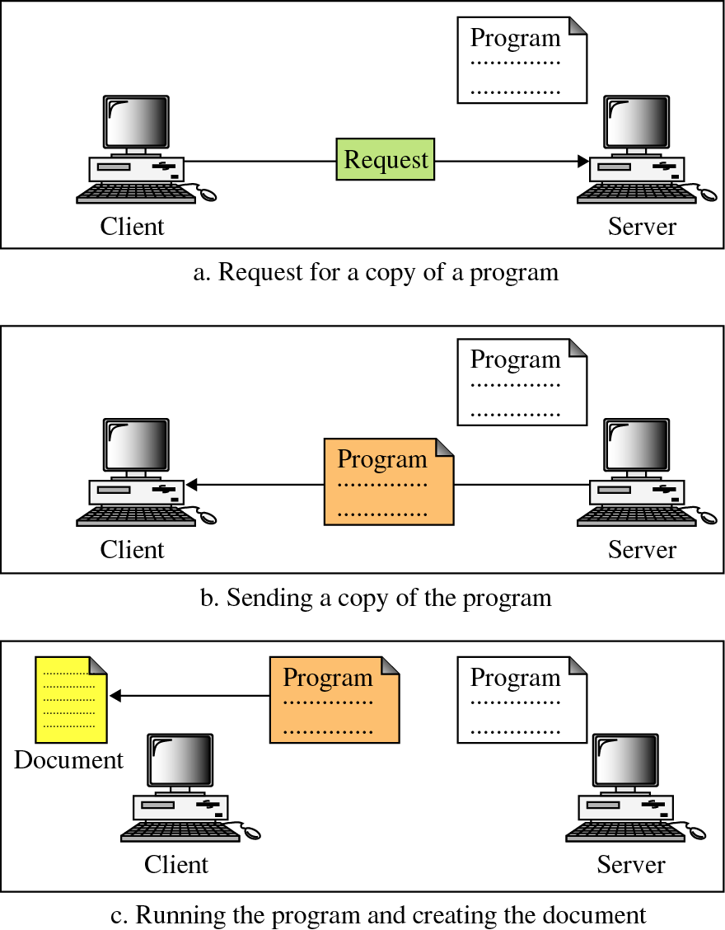

Figure 25-10
Active
document

